Slide 1

S
Evolution of Learning
Knowledge Network
Social
Employee Driven
Organic
Just-in-Time
Video/Documents/Social
Knowledge Sharing
Optimize
Blended
Social LMS
YouTube Enterprise
Facebook Enterprise
Microblogging
eLearning
Trainer
&
LMS
Classroom
Online Courses
(LMS)
S
Trainer
Formal Learning
Informal Learning
“ I HAVE to learn”
“I WANT to learn”

Slide 2
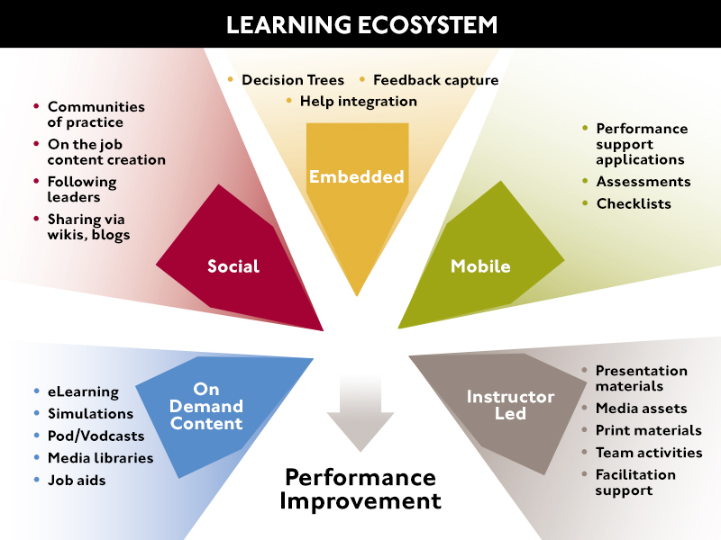
The Learning and Communications Ecosystem

Slide 3
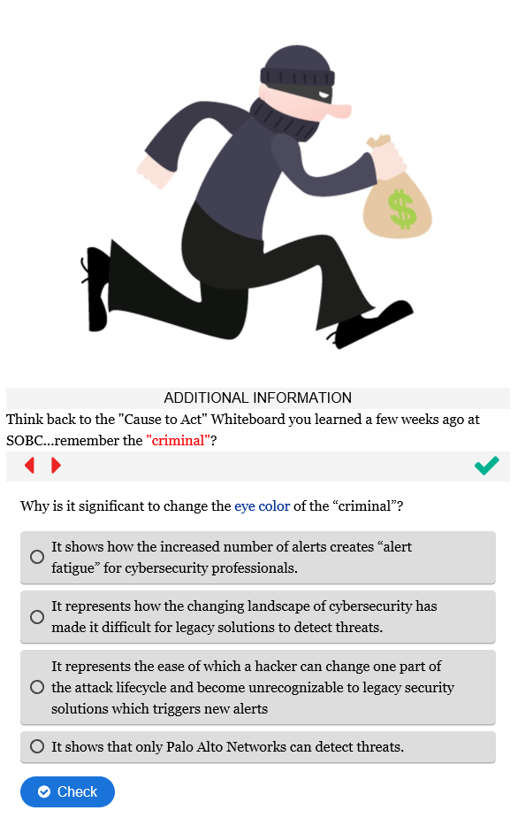
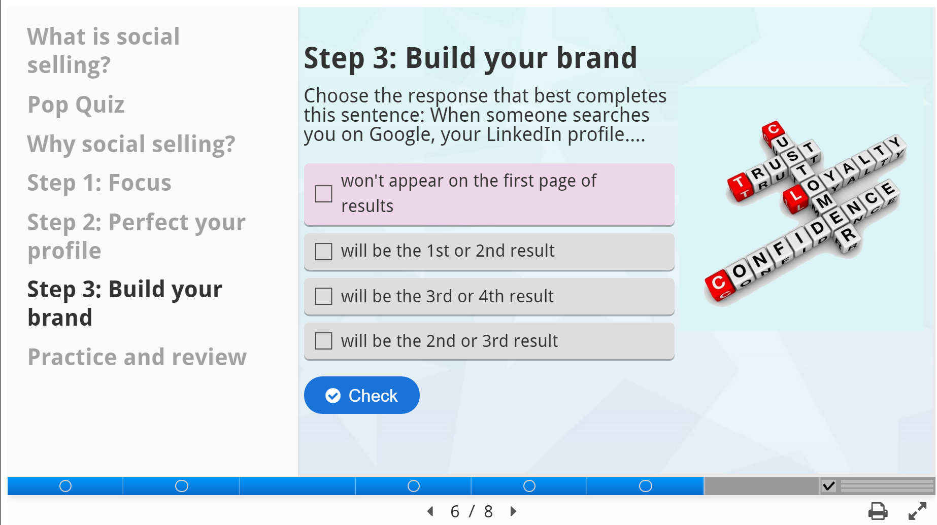

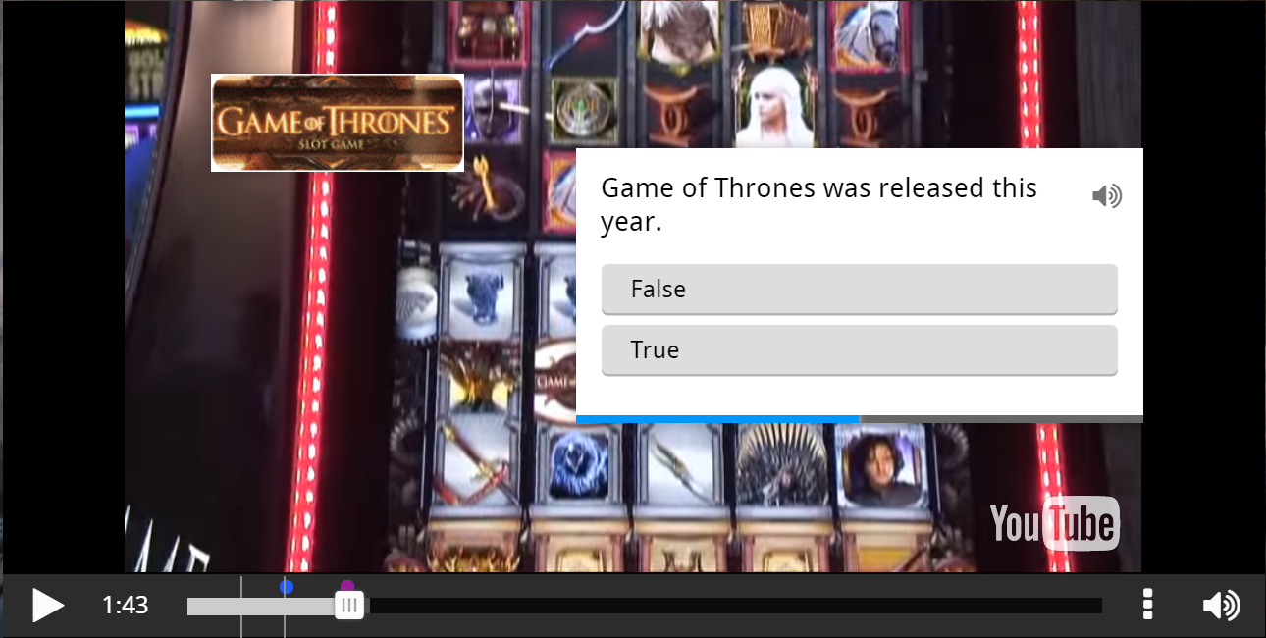



7 Interactive Content Types
Menu
Course
Micro Learning
Video
PowerPoint
PDF
Presentation

Slide 4
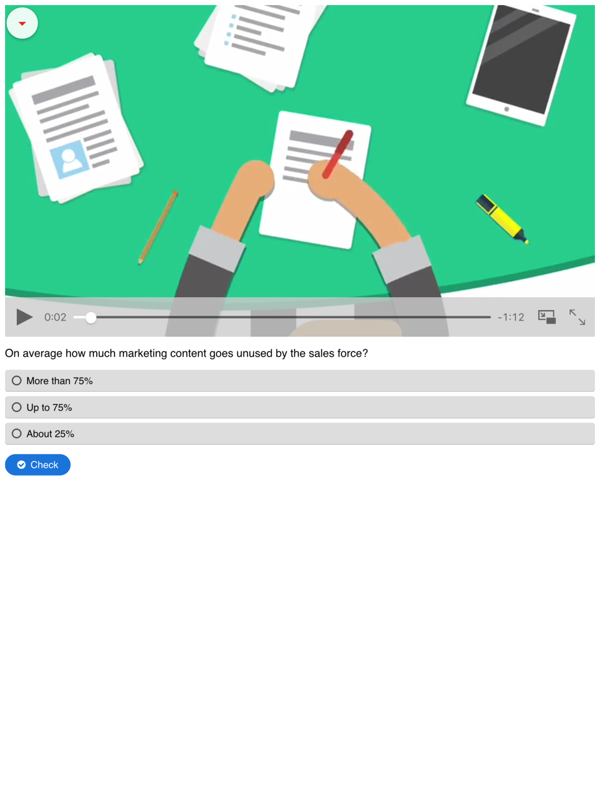
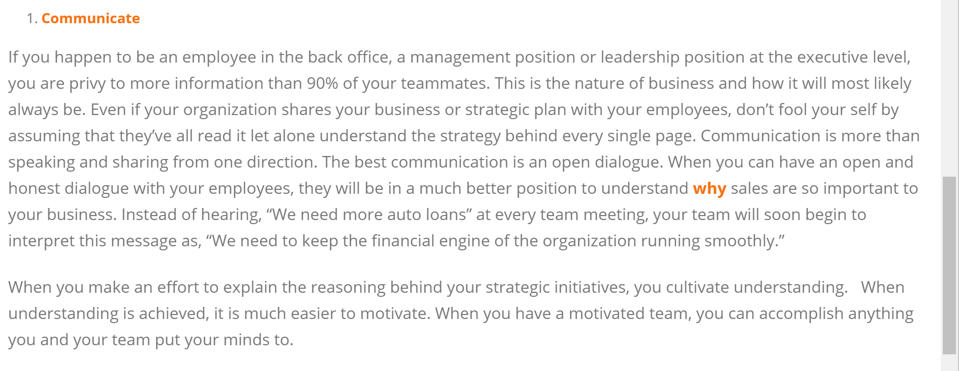
Micro Learning
Single Visual Asset:
Video,
Converted PDF or PPT,
Graphic,
URL (Website/Blog/YouTube)
A
B
Compose-able HTML5 Text
Optional Audio Object
Question Set –
1 to N
Single Choice, Multiple Choice, FITB, Score/Summary
C
A, B or C may be primary panel. Panels not selected may be turned on/off.

Slide 5




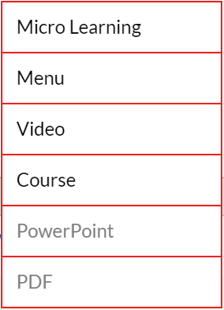
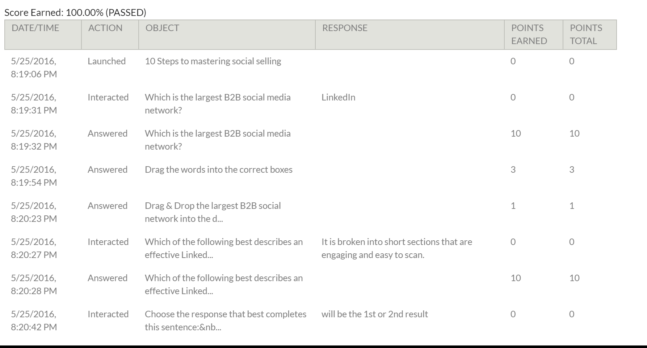

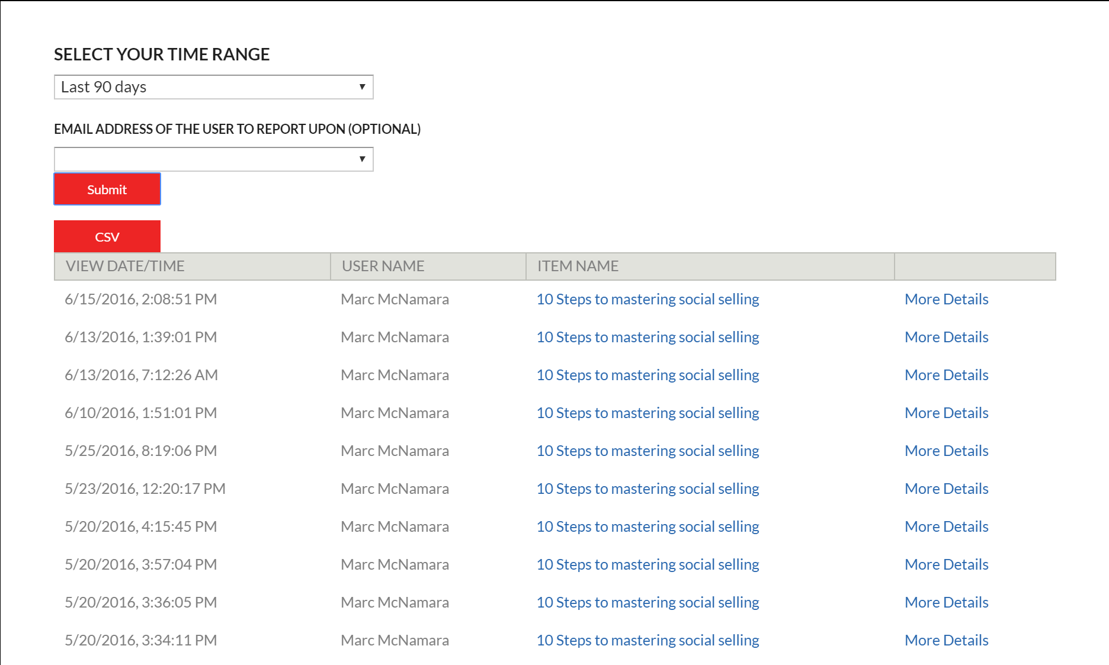

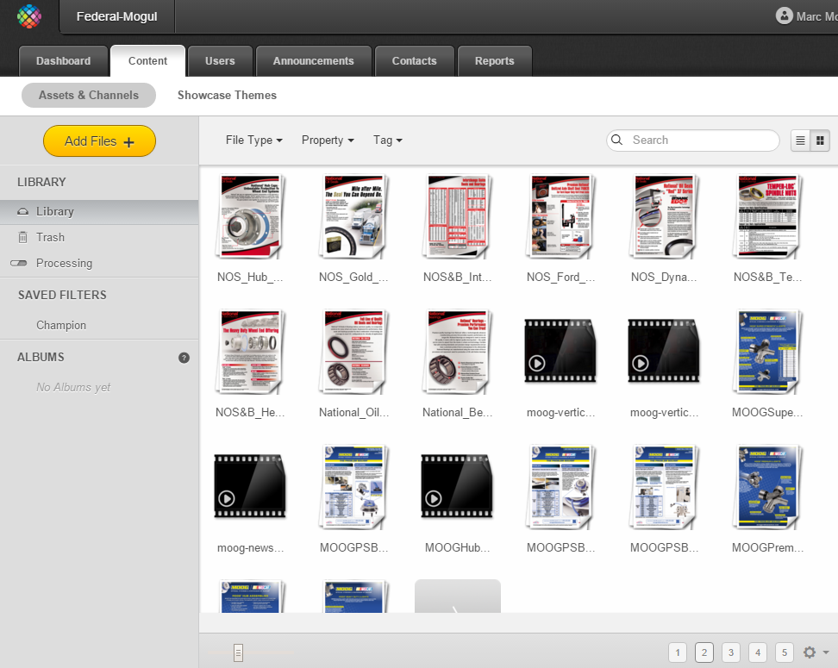








The Platform
Web
Content
Services
Content
Creator
Publisher
MOOC
CRM
Portals
PPT to HTML5
PDF to HTML5
SMS (Text)
Navigator
Email
Media Converter
Learning Content
Handlers
x API
“Tin Can API”
Library
Report
Generator
Mobile Online/Offline
Package
Learning Record Store (LRS)
v
v
Notes:
Again thank for listening. My hope is that this overview has been helpful in illustrating the value of the platform and the opportunity at hand. We look forward to our conversation with you on Monday

Slide 6

Customizable
Buttons
Headers
Fonts
Objects
Actions
Pallets
Layouts
Templates

Slide 7


HTML5 Conversions
Animations
Interactivity
Hyperlinks
Media
ppt
Trackable
Format
Interactivity
Hyperlinks
Media

Slide 8
SOURCE
BUILD
ORGANIZE
DISTRIBUTE
TRACK
Moderate
Capture Knowledge
ID Assets
Editorial
Amplify
Create
Taxonomy
Tagging
Governance
Access / Integration
Delivery / Share
Responsive / Devices
Measurement
Analyze
Feedback
OPTIMIZE
Improvements
Coaching
Communication
Notes:
Datum, Data, Reports and Analytics

Slide 9
Divisions
Administrative
CC DAM – exposes assets solely in ICC Authoring
Global Content– Shares finished content with all divisions
Provisioning – exposes ICC channels to all users
Company or Personal
Full Admin Control Over Division
Channels, Folders, Style, Etc.

